Slide 1
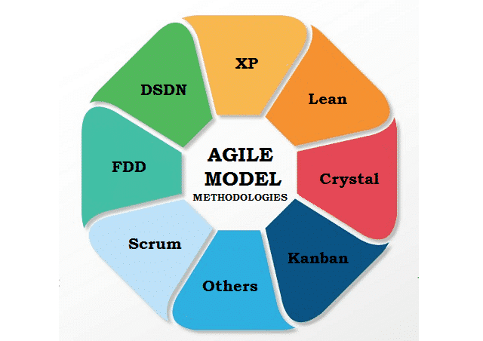
-------------
AGILE SOFTWARE DEVELOPNMENT(ASD) UNIT IV-Design Methodologies
By:- Revanth(160123748051),
Viswanath(160123748058)

Slide 2
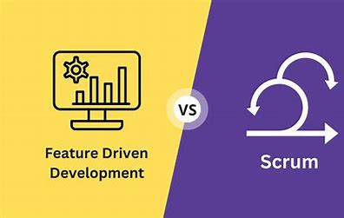
Topics Covered:-
Feature-Driven Development
Scrum Roles:-
Product Owner
Scrum Master
Scrum Team

Slide 3

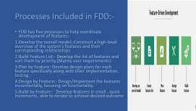
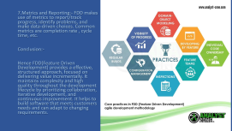
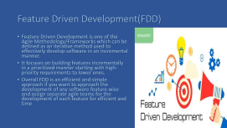
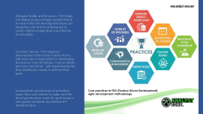
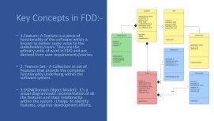
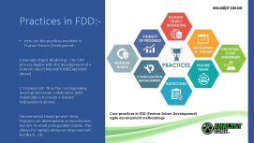
All About Feature Driven Development(FDD):-
All About Feature Driven Development:-
Definition:-
Key Concepts
Key Concepts:-
Processes in FDD:-
Practices in FDD(2):-
Practices in FDD:-
Practices in FDD(3):-
Note:- Feature Driven Development is a simple and incremental process if you aim to maintain the complex functionality in a simple manner within a software.

Slide 4

Feature Driven Development(FDD)
Feature Driven Development is one of the Agile Methodology/Frameworks which can be defined as an iterative method used to effectively develop software in an incremental manner.
It focuses on building features incrementally in a prioritized manner starting with high-priority requirements to lower ones.
Overall FDD is an efficient and simple approach if you want to approach the development of any software feature wise and assign separate agile teams for the development of each feature for efficient and time

Slide 5
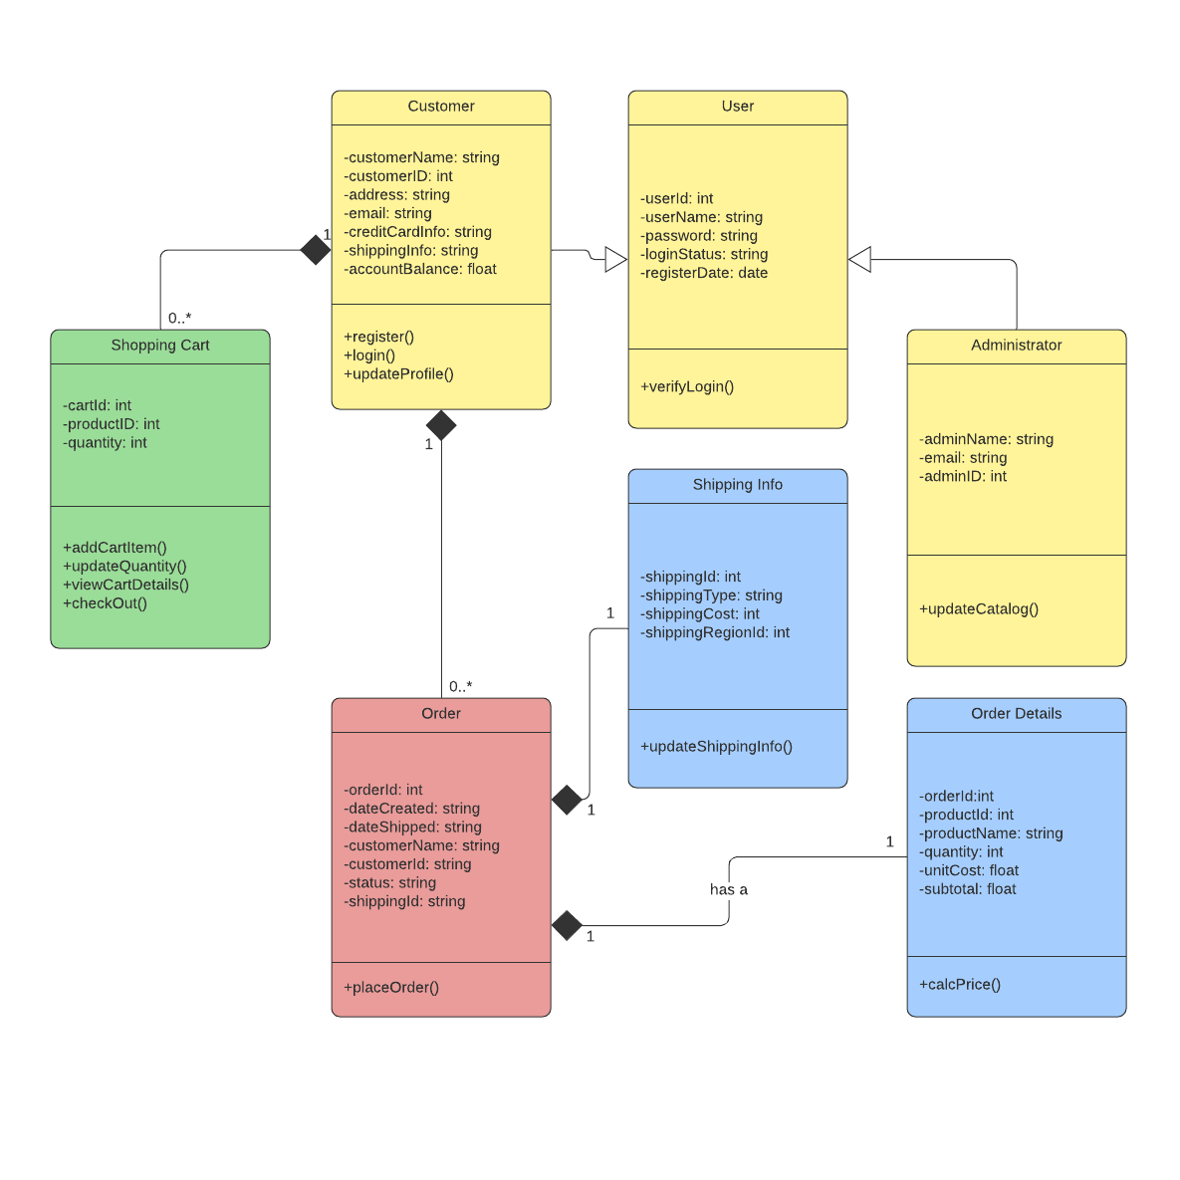
Key Concepts in FDD:-
1.Feature:-A Feature is a piece of functionality of the software which is known to deliver some value to the stakeholders/users. They are the primary units of work in FDD and are derived from user requirements/stories.
2. Feature Set:- A Collection or set of Features that provide the complete functionality underlying within the software system.
3.DOM(Domain Object Model):- It’s a visual diagrammatic representation of all the features and their relationship within the system. It helps to identify features, organize development efforts.

Slide 6
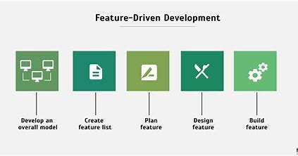
Processes Included in FDD:-
FDD has five processes to help coordinate development of features:-
1.Develop the overall model:-Construct a high-level overview of the system’s features and their corresponding relationships
2.Build Feature List:- Develop the list of features and sort them by priority.(Mainly user requirements)
3.Plan by Feature:-Develop design plans for each feature specifically along with their implementation, testing.
4.Design by Feature:- Design/Implement the features incrementally, focusing on functionality.
5.Build by Feature:- Develop features in small , quick increments, able to iterate to achieve desired outcome

Slide 7
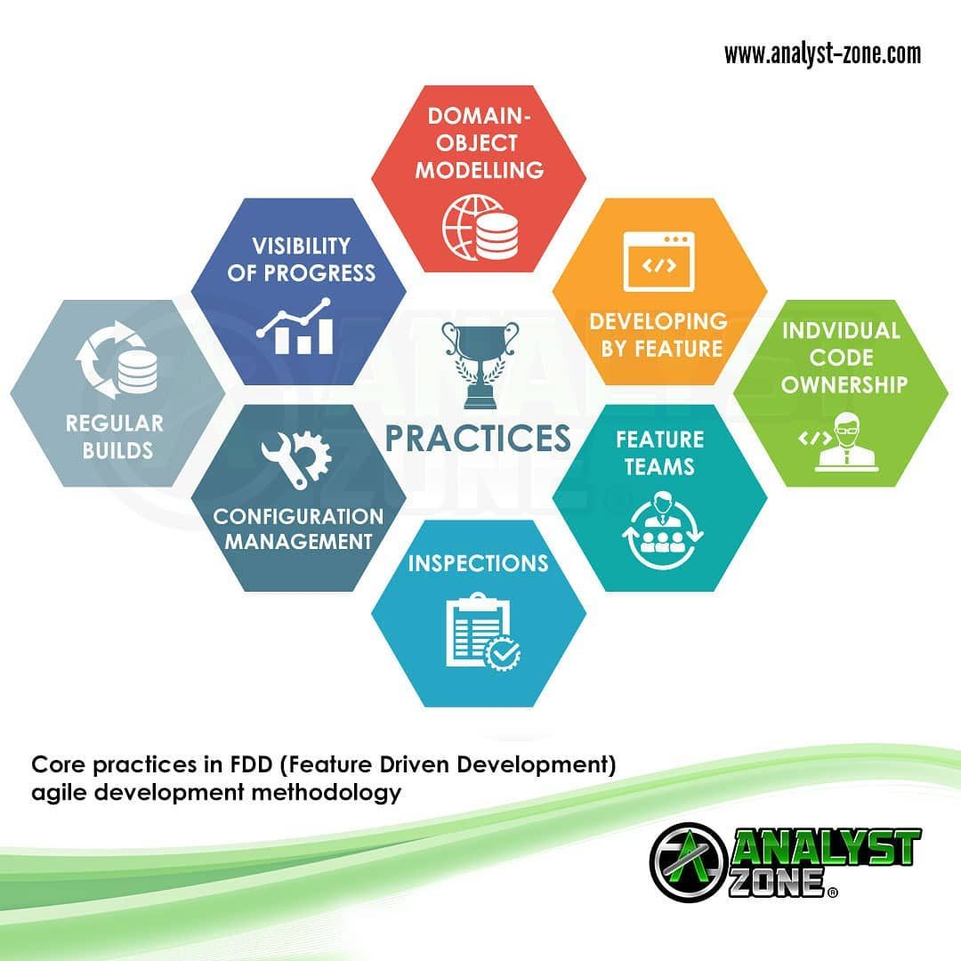
Practices in FDD:-
Here are the practices involved in Feature Driven Development:-
1.Domain Object Modelling:- The FDD process begins with the development of a Domain Object Model(DOM)(Explained above).
2. Feature List:-Then the corresponding development team collaborates with stakeholders to create a feature list(Explained above).
3.Incremental Development:-Here, Features are developed in an incremental manner in small ,manageable chunks. This allows for rapid/continuous improvement , feedback , etc.

Slide 8
4.Regular Builds and Releases:- FDD helps in building rapid prototype models/builds to ensure that the developed features are integrated and tested continuously to ensure efficient integration and effective functionality.
5.Feature Teams:- FDD organizes development efforts into Feature teams, with each team responsible for developing features or a set of features. Feature teams are cross-functional , self-organizing teams that collaborate closely to achieve their goals.
6.Inspections and Reviews:-It prioritizes inspections and reviews to make sure the developed features meet the performance and quality standards and delivers it’s intended value.

Slide 9
7.Metrics and Reporting:- FDD makes use of metrics to report/track progress, identify problems, and make data-driven choices. Common metrics are completion rate , cycle time, etc.
Conclusion:-
Hence FDD(Feature Driven Development) provides a effective, structured approach, focused on delivering value incrementally. It maintains complexity and high quality throughout the development lifecycle by prioritizing collaboration, iterative development, and continuous improvement. It helps to build software that meets customers needs and can adapt to changing requirements.

Slide 10
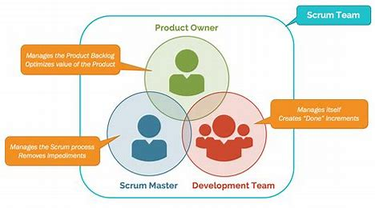
Scrum Roles:-
There are three main roles in the Scrum Team that ensure the efficient implantation of Scrum practices and ensures success of the project:-
1.Product Owner
2. Scrum Master
3.Scrum Team

Slide 11
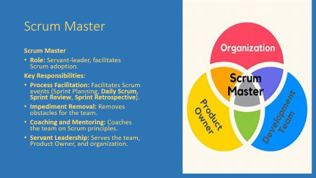
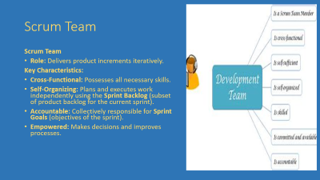
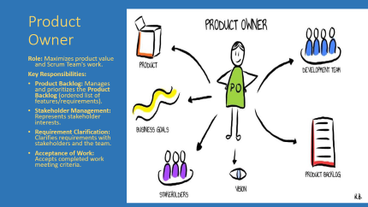
Scrum Roles:-
Product Owner:-
Scrum Master:-
Scrum Team:-

Slide 12
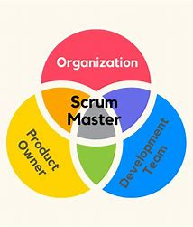
Scrum Master
Scrum Master
Role: Servant-leader, facilitates Scrum adoption.
Key Responsibilities:
Process Facilitation: Facilitates Scrum events (Sprint Planning, Daily Scrum, Sprint Review, Sprint Retrospective).
Impediment Removal: Removes obstacles for the team.
Coaching and Mentoring: Coaches the team on Scrum principles.
Servant Leadership: Serves the team, Product Owner, and organization.

Slide 13
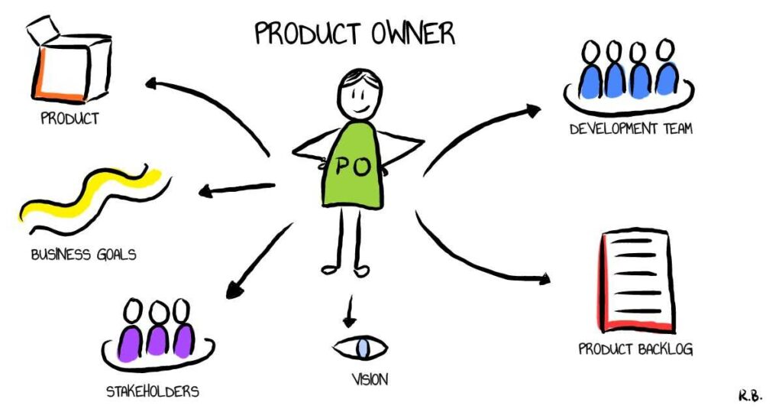
Product Owner
Role: Maximizes product value and Scrum Team's work.
Key Responsibilities:
Product Backlog: Manages and prioritizes the Product Backlog (ordered list of features/requirements).
Stakeholder Management: Represents stakeholder interests.
Requirement Clarification: Clarifies requirements with stakeholders and the team.
Acceptance of Work: Accepts completed work meeting criteria.

Slide 14
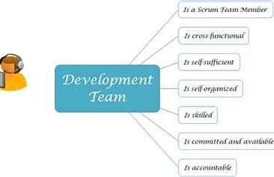
Scrum Team
Scrum Team
Role: Delivers product increments iteratively.
Key Characteristics:
Cross-Functional: Possesses all necessary skills.
Self-Organizing: Plans and executes work independently using the Sprint Backlog (subset of product backlog for the current sprint).
Accountable: Collectively responsible for Sprint Goals (objectives of the sprint).
Empowered: Makes decisions and improves processes.

Slide 15

THANK YOU!!!!

